Slide 1
Computer Network (CS3002)
Spring Semester (2021-2022)
Dr. Judhistir Mahapatro
Department of Computer Science and Engineering
National Institute of Technology Rourkela

Slide 2
Introduction to Computer Networks (Lecture-2)

Slide 3
Network Software
Protocol hierarchies
Design issues for the layers
Connection-oriented versus connectionless service
Service primitives
Relationship of services to protocols

Slide 4
Protocol hierarchies
Most networks organized as a stack of layers or levels, each one built upon the one below.
Each layer provides services to higher layers while shielding the implementation of those offered services.
A protocol is an agreement between the communicating parties on how communication is to proceed.

Slide 5
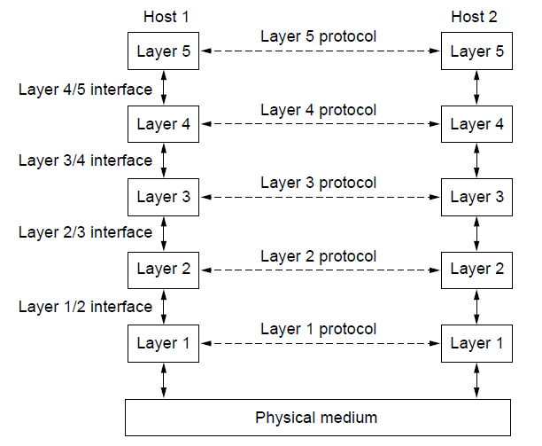
Protocol Hierarchies
Interface defines which primitive operations and services the lower layer makes available to the upper one.
A set of layers and protocols is called a network architecture.
A list of protocols used by a certain system, one protocol per layer, is a called protocol stack.
Layers, protocols, and interfaces.

Slide 6
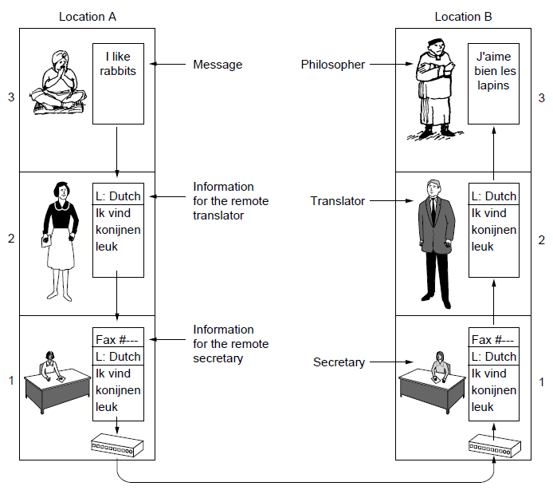
Protocol Hierarchies
The philosopher-translator-secretary architecture

Slide 7
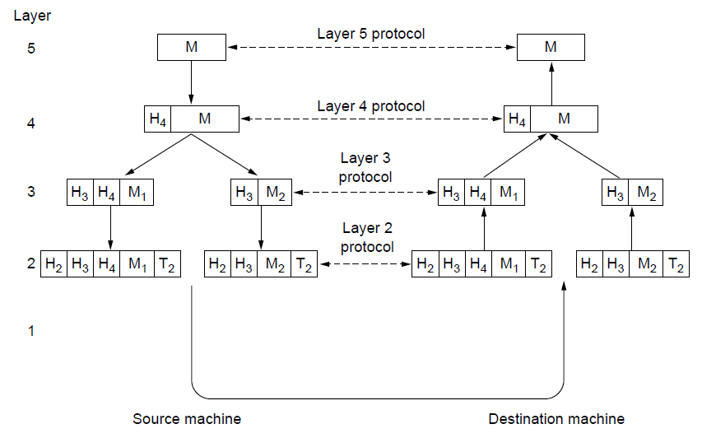
Protocol Hierarchies
Example information flow supporting virtual
communication in layer 5.

Slide 8
Design issues for the layers
Reliability issue that the bits of the packet travelling through the network.
  Some bits might be inverted due to many reasons such as electrical noise, random wireless signals, hardware flaws, software bugs etc.
  How to detect and fix these errors?
    Error detection uses codes
    Incorrectly received packet can then be retransmitted until it is received correctly.
    Powerful codes allow for error correction.
    Both mechanism work by adding redundant information

Slide 9
Design issues for the layers
  Finding a working path through a network
    Often there are multiple paths
    network should automatically decide to switch to the other working path in case the current path is broken.
      This topic is called Routing.

Slide 10
Design issues for the layers
Design issue concerns the evolution of the network.
  New designs emerge and that need to be connected to the existing network.
    Support change by protocol layering.
  Every layer needs a mechanism for identifying the senders and receivers that are involved in a particular message.
    This mechanism is called addressing or naming.

Slide 11
Design issues for the layers
  Resource allocation
    Mechanisms that divide the resources so that one host don’t interfere with another.
      Share network bandwidth dynamically.
    An allocation problem that occur is how to keep a fast sender from swamping a slow receiver with data. This subject is called flow control.

Slide 12
Design issues for the layers
  Resource allocation
    Too much traffic generated from many senders, network cannot deliver it all.
      This overloading of network is called congestion.
    Applications that want real-time delivery at the same time want high throughput. (Quality of Service)

Slide 13
Design issues for the layers
  Last design issue is to secure the network
    by defending it against various kinds of threats.

Slide 14
Connection-Oriented Versus
Connectionless Service
Service user first establishes a connection, uses the connection, and then release the connection.
Order is preserved so that the bits arrive in the order they were sent.
  Example: it is modeled after telephone system
Sender, receiver, subnet negotiate about the parameters to use, such as maximum message size, QoS etc.
A circuit is another name for a connection with associated resources, such as fixed bandwidth.

Slide 15
Connection-Oriented Versus
Connectionless Service
Connectionless service is modeled after the postal system.
  Each message carries the full destination address and each one is routed through intermediate nodes independent of all subsequent messages.
  A packet is a message at the network layer
  Store-and-forward switching
Each kind of service can further be characterized by its reliability.
  They never lose data
  Receiver acknowledge the receipt of each message
  Example: file transfer

Slide 16
Connection-Oriented Versus
Connectionless Service
Reliable connection-oriented service has two minor variations
  Message sequences, the message boundaries are preserved.
    Example, two 1024-byte messages are sent, they arrive as two distinct 1024-byte messages.
  Byte streams, simply a stream of bytes
    Example, download a DVD movie.

Slide 17
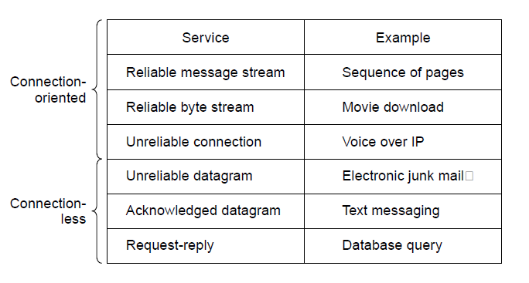
Connection-Oriented Versus
Connectionless Service
Six different types of service.

Slide 18
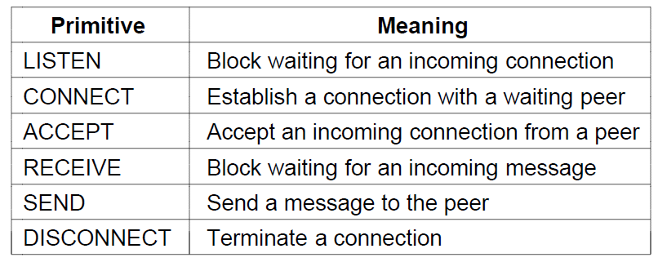
Service Primitives
Six service primitives that provide a simple
connection-oriented service

Slide 19
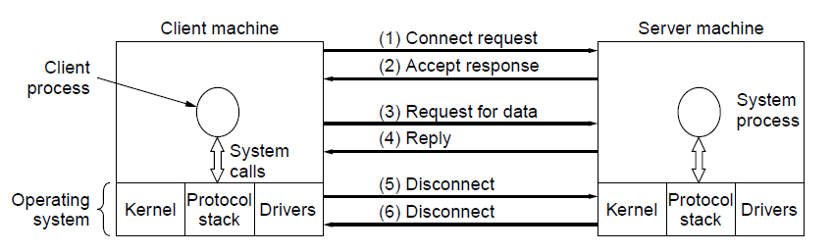
Service Primitives
A simple client-server interaction using
acknowledged datagrams.

Slide 20
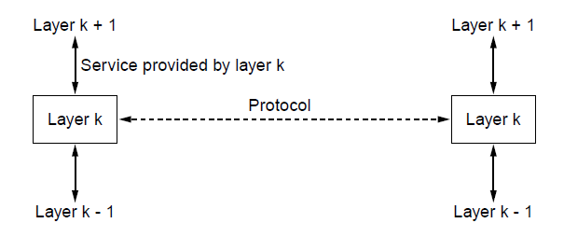
The Relationship of Services to Protocols
The relationship between a service and a protocol.

Slide 21
Reference Models
OSI reference model
TCP/IP reference model
Model used for this text
Comparison of OSI and TCP/IP
Critique of OSI model and protocols
Critique of TCP/IP model

Slide 22
The OSI Reference Model
OSI (Open Systems Interconnection) model is based on the proposal developed by the International Standards Organization (ISO)
  first step toward international standardization of protocols at various layers.

Slide 23
The OSI Reference Model
Principles for the seven layers
  Layers created for different abstractions
  Each layer performs well-defined function
  Function of layer chosen with definition of international standard protocols in mind
  Minimize information flow across interfaces between boundaries
  Number of layers optimum

Slide 24
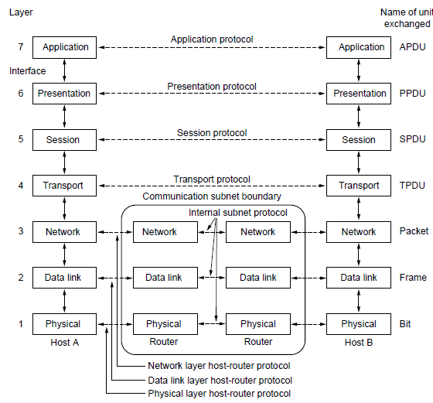
The OSI Reference Model

Slide 25
THE OSI MODEL
Established in 1947, ISO is a multinational body dedicated to worldwide agreement on international standards.
An ISO standard that covers all aspects of network communications is the Open Systems Interconnection (OSI) model.
  It was first introduced in the late 1970s.
Notes:
1.#

Slide 26
ISO is the organization.
OSI is the model.
Notes:
1.#

Slide 27

Seven layers of the OSI model
Notes:
1.#

Slide 28

The interaction between layers in the OSI
Notes:
1.#

Slide 29

An exchange using the OSI model
Notes:
1.#

Slide 30

Physical layer
Concerned with transmitting raw bits over a communication channel.
Make sure that when one side sends a 1 bit it is received by the other side as a 1 bit, not as a 0 bit.
Notes:
1.#

Slide 31
Physical layer
What electrical signal is used to represent a 1 and a 0
How many nanoseconds a bit lasts
Transmission modes
  Simplex: unidirectional communication
  Half duplex: Bidirectional communication but at a time only from one side
  Full duplex: Bidirectional communication but at a time from both direction communication can take place
How initial connection is established
How many pins the network connector has
Largely it deals with electrical, mechanical and timing interfaces as well as physical transmission medium.
Notes:
1.#

Slide 32
The physical layer is responsible for movements of
individual bits from one hop (node) to the next.
Notes:
1.#

Slide 33

Data link layer
Transforms a raw transmission facility into a line that appears free of undetected transmission errors.
Masking the real errors so the network layer does not see them.
Sender break up the input data into data frames and transmit the frames sequentially.
For reliable service, acknowledgement is used
Notes:
1.#

Slide 34
Data link layer
Issue that how to keep a fast transmitter from drowning a slow receiver in data.
  Traffic mechanism is needed to let the transmitter know when to transmit more data.
Broadcast network, an additional issue that how to control access to the shared medium.
  MAC sublayer is used
Notes:
1.#

Slide 35
The data link layer is responsible for moving
frames from one hop (node) to the next.
Notes:
1.#

Slide 36

Hop-to-hop delivery
Notes:
1.#

Slide 37

Network layer
Controls the operation of subnet.
How packets are routed from source to destination.
Static tables that are wired into the network and rarely changed, or more often they can be updated automatically to avoid failed components.
Notes:
1.#

Slide 38
Network layer
Handling congestion in conjunction with higher layers that adapt load.
QoS is also provided.
Notes:
1.#

Slide 39
Network layer
When packet travel from one network to other network, different addressing may be used.
Second network may not accept the packet for too large size.
Protocol used may be different.
Broadcast networks, routing is very simple.
Notes:
1.#

Slide 40
The network layer is responsible for the
delivery of individual packets from
the source host to the destination host.
Notes:
1.#

Slide 41

Source-to-destination delivery
Notes:
1.#

Slide 42

Transport layer
Split the data accepted from upper layer up into smaller units
Pass these to the network layer
Ensure that the pieces all arrive correctly at the other end.
Notes:
1.#

Slide 43
Transport layer
Popular type of transport connection is an error-free point-to-point channel that delivers messages or bytes in the order in which they were sent.
Other transport services, such as the transporting of isolated messages with no guarantee about the order of delivery, broadcasting of messages to multiple destinations.
Notes:
1.#

Slide 44
Transport layer
Type of service is determined when the connection is established.
It is a true end-to-end layer; a program on the source machine carries on a conversation with a similar program on the destination machine.
In lower layers, each protocol is between the machine and its immediate neighbors.
Notes:
1.#

Slide 45
The transport layer is responsible for the delivery
of a message from one process to another.
Notes:
1.#

Slide 46

Reliable process-to-process delivery of a message
Notes:
1.#

Slide 47

Session layer
It allows users on different machines to establish sessions between them.
Notes:
1.#

Slide 48
Session layer
Dialog control: keeping track of whose turn it is to transmit
Token management: preventing two users from attempting the same critical operation simultaneously.
Synchronization: check pointing long transmissions for the event of a crash and recovery.
Notes:
1.#

Slide 49
The session layer is responsible for dialog
control and synchronization.
Notes:
1.#

Slide 50

Presentation layer
It is concerned with the syntax and semantics of the information transmitted.
Important functions of the presentation layer are Translation, Encryption and Compression.
Notes:
1.#

Slide 51
Presentation layer
Translation
  Characters and numbers should be changed to bit streams.
  translates data between the formats the network requires and the format the computer
  Different computers use different encoding methods
Encryption
  Information is encrypted at the transmitter and decrypted at the receiver side.
Compression
  Reduce the number of bits to be transmitted.
Notes:
1.#

Slide 52
Presentation layer
Make it possible for computers with different internal data representations to communicate,
The data structures to be exchanged can be defined in an abstract way,
The standard encoding to be used on the wire.
Notes:
1.#

Slide 53
The presentation layer is responsible for translation, compression, and encryption.
Notes:
1.#

Slide 54

Application layer
Notes:
1.#

Slide 55
Application layer
It contains a variety of protocols that are commonly needed by users.
HTTP(Hyper Text Transfer Protocol) is a widely used application protocol for the WWW.
  It sends the name of the page it wants to the server hosting the page using HTTP.
  Server then sends back the page.
Other application protocols are used for file transfer, electronic mail, and network news.
Notes:
1.#

Slide 56
The application layer is responsible for
providing services to the user.
Notes:
1.#

Slide 57

Summary of layers
Notes:
1.#

